Slide 1


MOVIE RECOMMENDATION SYSTEM
PRESENTED BY:
K. Viswa
513121104309
CSE III Year
TPGIT , Vellore

Slide 2

AGENDA
Problem Statement
Proposed Solution
Who are the End users
The WOW in my solution
System Development Approach
Algorithm & Deployment
Result
Conclusion
Reference

Slide 3
PROBLRM STATEMENT
The problem at hand is the need for an effective movie recommendation system that can provide personalized suggestions to users based on their preferences. Traditional recommendation systems often rely on collaborative filtering or content-based filtering, which may not capture the nuanced preferences of users accurately. Moreover, as the volume of available movies continues to grow, there is a demand for more sophisticated approaches to handle the increasing diversity and complexity of movie data.

Slide 4

PROPOSED SOLUTION
Our proposed solution leverages generative AI techniques to enhance movie recommendations by learning from user interactions and generating personalized suggestions. By employing advanced machine learning algorithms, our system aims to address the limitations of traditional recommendation approaches and deliver more accurate and engaging movie recommendations.

Slide 5


WHO ARE THE END USERS
General Movie Enthusiasts: These users seek personalized movie recommendations to discover new films aligned with their tastes and preferences. They may use the recommender system through various platforms like websites, mobile apps, or smart TVs.
Streaming Platforms: Platforms such as Netflix or Amazon Prime Video can integrate the recommender system to enhance user experience by providing tailored movie suggestions. Subscribers rely on recommendations to navigate the vast library of available content.
Movie Review Websites: Websites like IMDb or Rotten Tomatoes could implement the recommender system to offer personalized movie suggestions to their visitors. Users visit these sites seeking recommendations based on their interests and preferences

Slide 6

THE WOW IN MY SOLUTION
Personalization: By leveraging generative AI models, your recommender system can understand individual user preferences with greater accuracy, providing recommendations tailored to each user's unique tastes and interests.
Diversity and Novelty: The incorporation of Generative Adversarial Networks (GANs) enables your system to generate diverse and novel movie recommendations, ensuring that users are exposed to a wide range of content beyond their usual preferences.
Continuous Learning: Through feedback mechanisms, your system continuously learns from user interactions and adapts its recommendations over time, improving the accuracy and relevance of suggestions with each interaction.

Slide 7
SYSTEM APPROACH
Data Collection & Preprocessing: Gather movie data from sources like IMDb, preprocess, and clean the dataset.
User Profile Creation: Allow users to create profiles and input preferences such as favorite genres, actors, and directors.
Recommendation Engine: Utilize the trained generative AI model to generate personalized movie recommendations based on user profiles and historical interactions.
Interactive Interface: Develop an intuitive user interface where users can explore recommendations, provide feedback, and refine preferences.
Continuous Learning: Incorporate feedback mechanisms to update user profiles and improve recommendation accuracy over time.
Scalable Deployment: Deploy the recommendation system on cloud infrastructure to handle large volumes of users and provide seamless experiences across devices

Slide 8


ALGORITHM & DEPLOYMENT
Data Preprocessing: Clean and preprocess the movie dataset, extracting relevant features.
Training Collaborative Filtering Model: Build a collaborative filtering model to capture user preferences and item similarities.
Training GANs: Train GANs to generate synthetic user-item interactions, enhancing the diversity of recommendations.
Recommendation Generation: Combine collaborative filtering results with GAN-generated recommendations to produce personalized suggestions.
Deployment: Deploy the recommendation system on a scalable platform, such as a web application or mobile app, to provide real-time recommendations to users

Slide 9
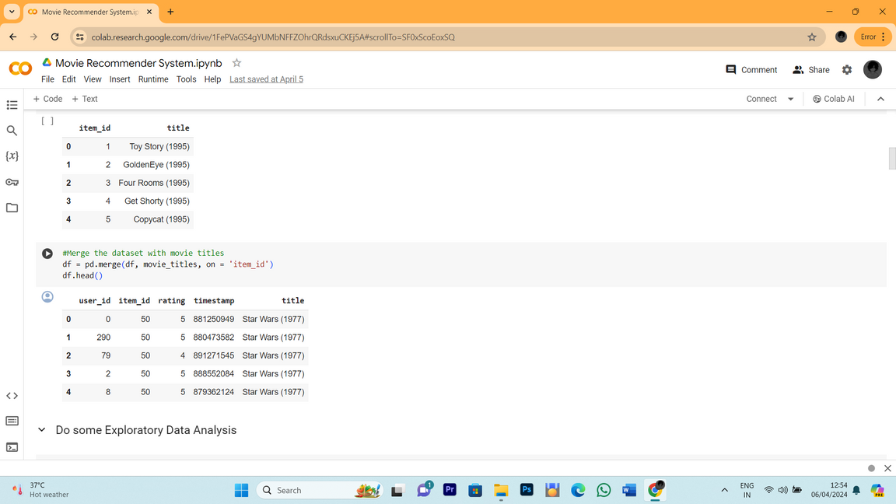
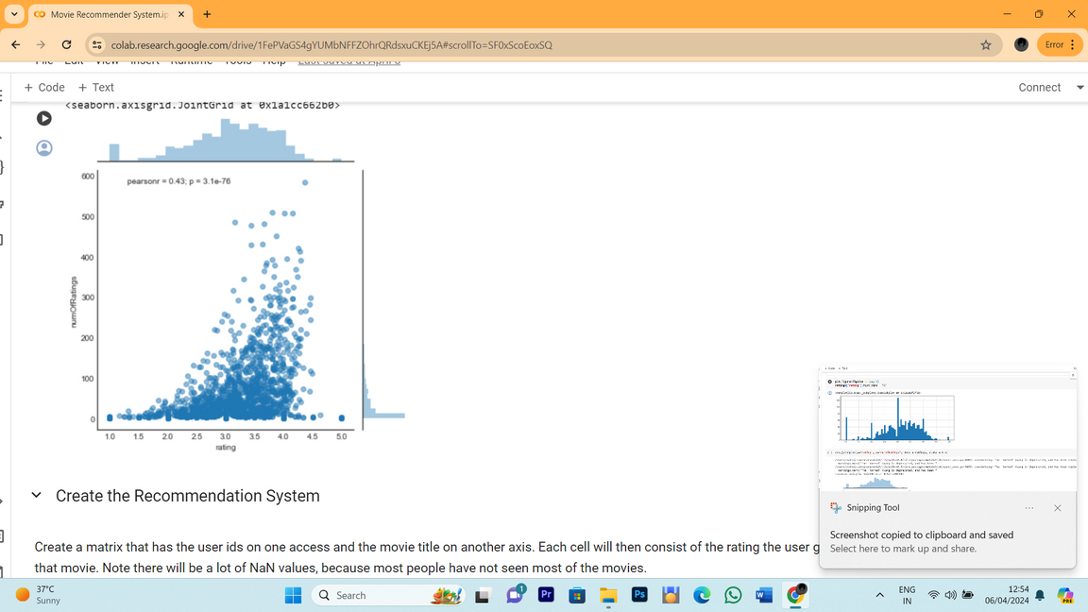
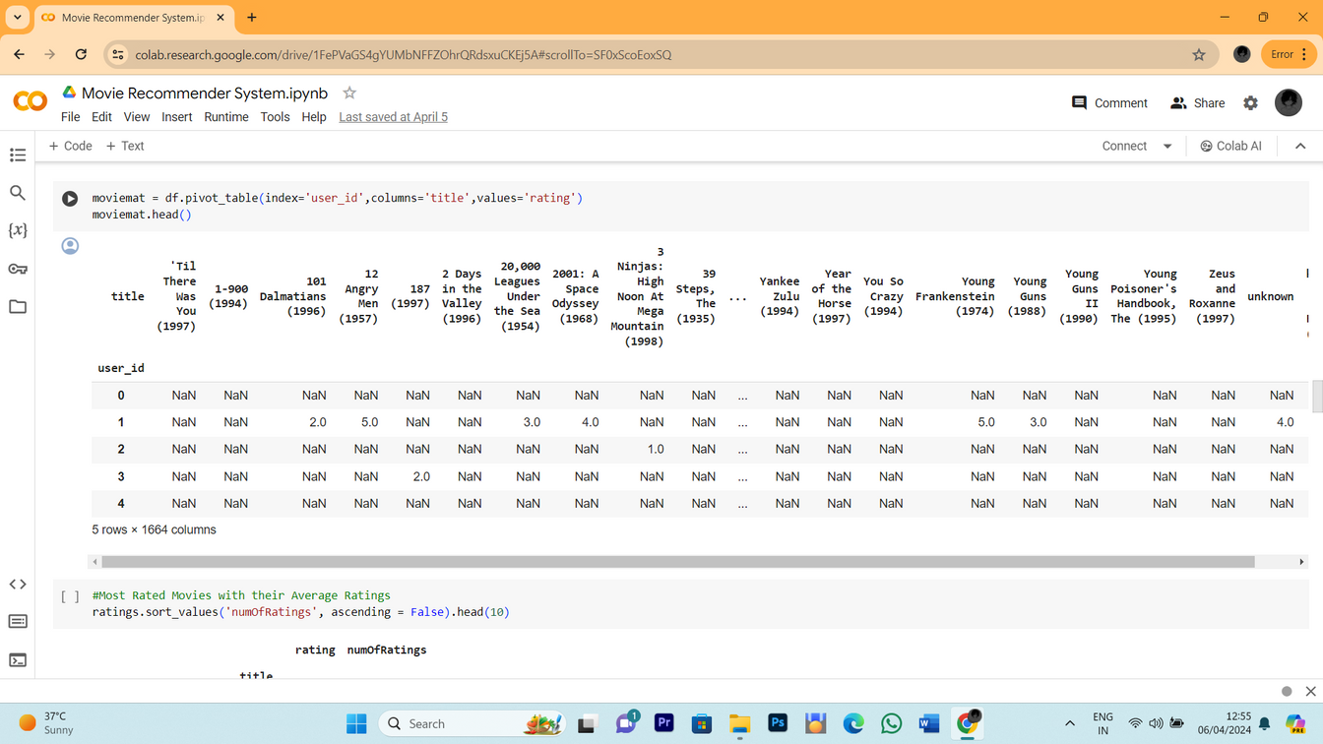
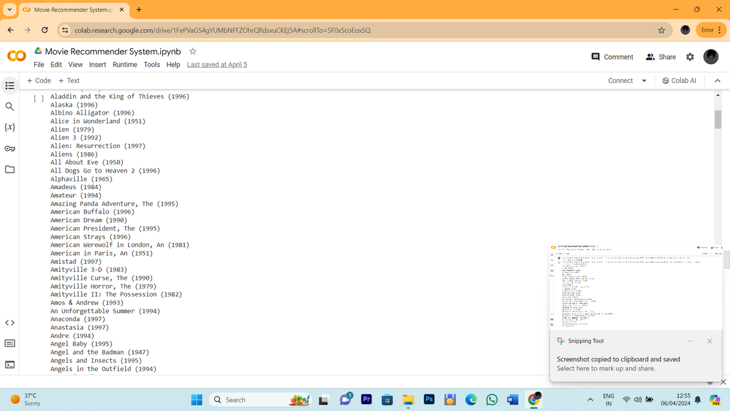
RESULT

Slide 10
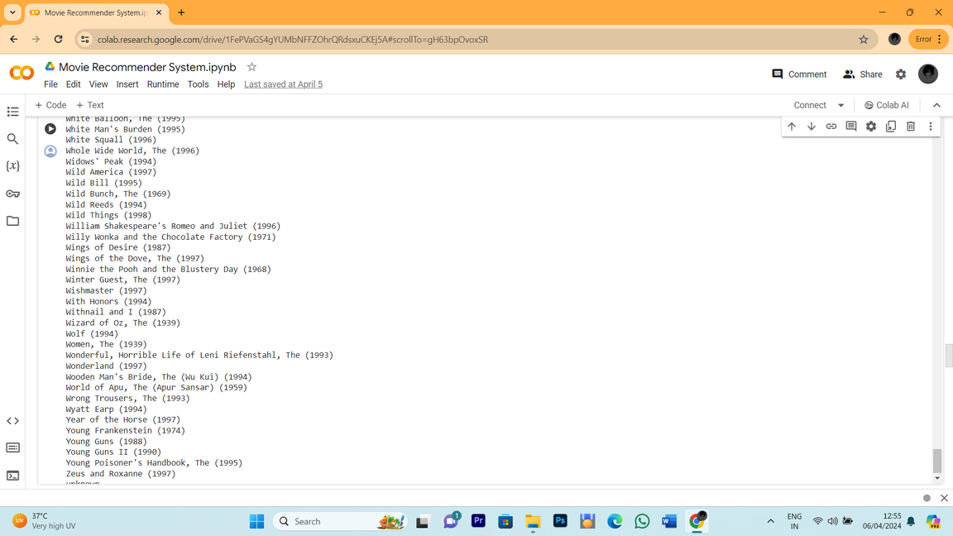
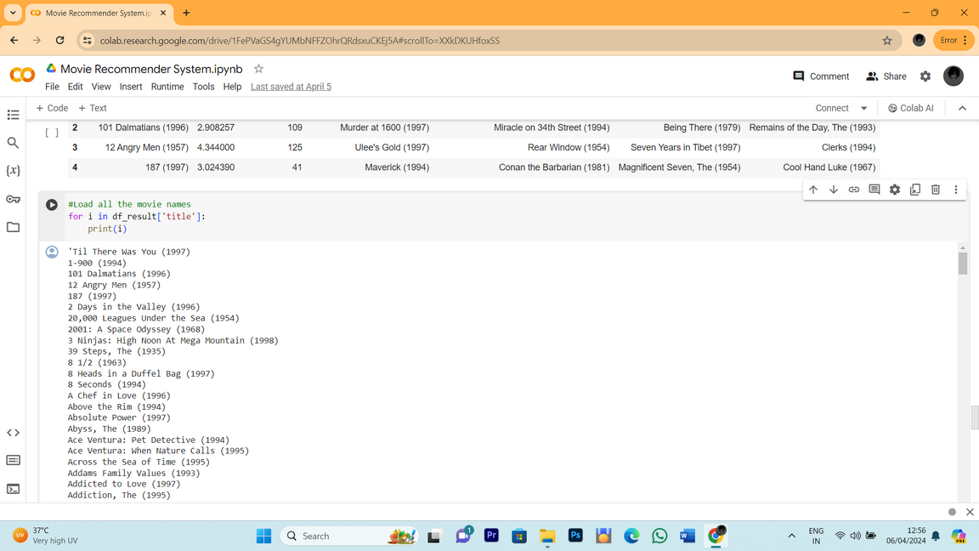
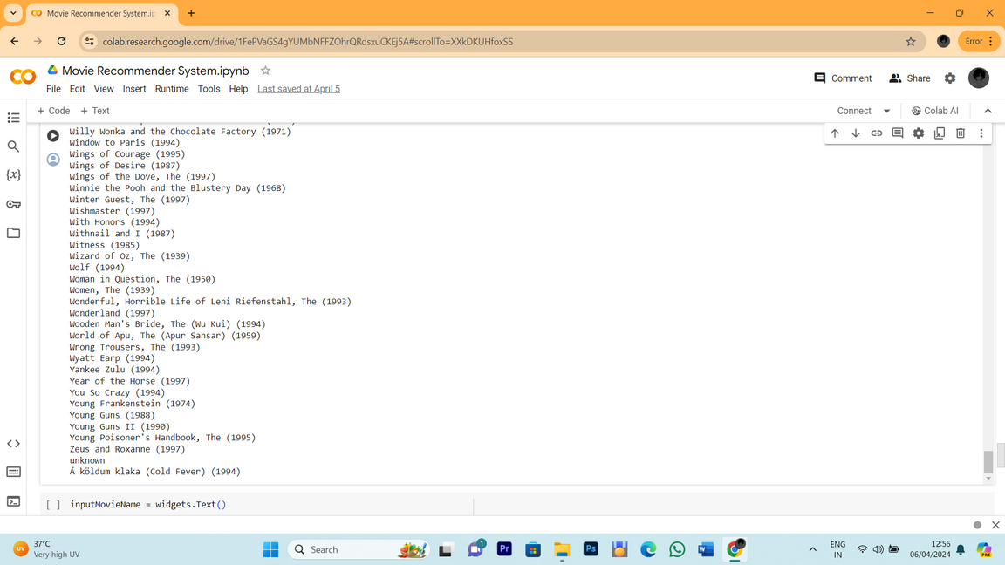
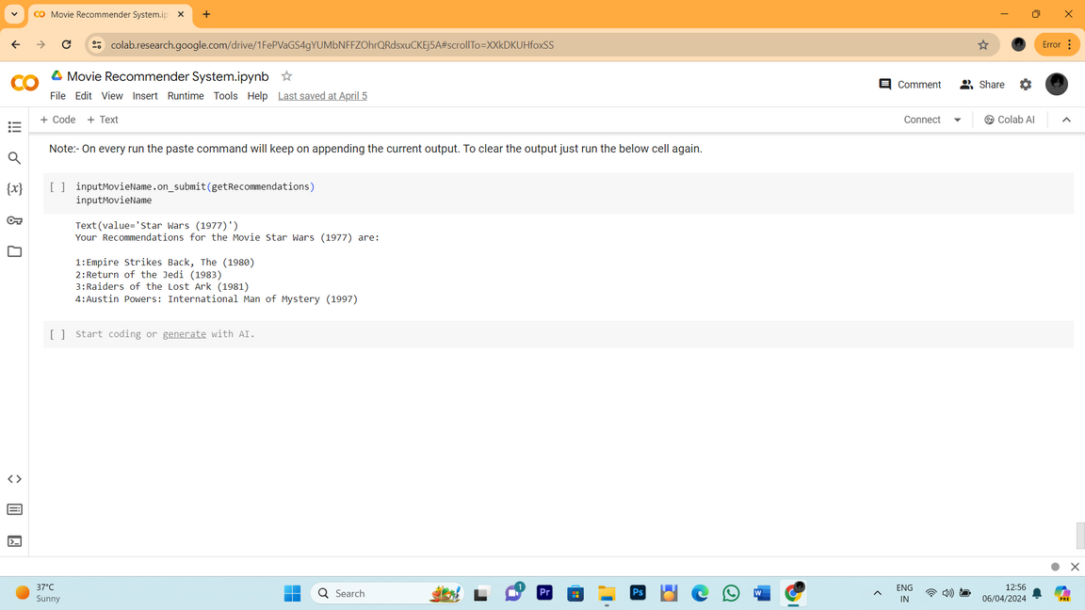

Slide 11

CONCLUSION
In conclusion, our project presents a groundbreaking approach to movie recommendation through the integration of advanced generative AI techniques with traditional collaborative filtering methods. By harnessing the power of Generative Adversarial Networks (GANs) alongside user interaction data, we have created a system that not only delivers highly personalized movie suggestions but also ensures diversity and novelty in recommendations.
Through continuous learning mechanisms, our system evolves with user feedback, refining its recommendations over time to better suit individual preferences. Scalable and user-friendly, our solution is poised to revolutionize the way users discover and engage with movies across various platforms, from streaming services to movie review websites.

Slide 12

REFERENCE
"Recommender Systems: An Introduction" by Dietmar Jannach, Markus Zanker, Alexander Felfernig, Gerhard Friedrich
"Programming Collective Intelligence: Building Smart Web 2.0 Applications" by Toby Segaran
GitHub hosts numerous repositories containing implementations of recommendation algorithms
https://github.com/pandas-dev/pandas
https://github.com/numpy/numpy
https://github.com/matplotlib/matplotlib
https://github.com/ipython/ipython

